Slide 1

Data Structures
Week 6 - Memory Management in C
Juan Carlos Pineda
ITESM
juancarlos.pineda@itesm.mx

Slide 2
Basic Real Life Task
Write down your home address
Exercise
What is the difference between your house and what’s written down in the piece of paper?
Notes:
5 minutes

Slide 3
Pointers in C/C++
Pointers store address of variables or a memory location.
General syntax datatype *var_name; // An example pointer "ptr" that holds // address of an integer variable or holds // address of a memory whose value(s) can // be accessed as integer values through "ptr" int *ptr;

Slide 4
Using pointers in C
To access address of a variable to a pointer, we use the unary operator & (ampersand) that returns the address of that variable. For example &x gives us address of variable x.
// The output of this program can be different // in different runs. Note that the program // prints address of a variable and a variable // can be assigned different address in different // runs.
#include <stdio.h> int main() {
int x; // Prints address of x printf("%p", &x); return 0; }

Slide 5
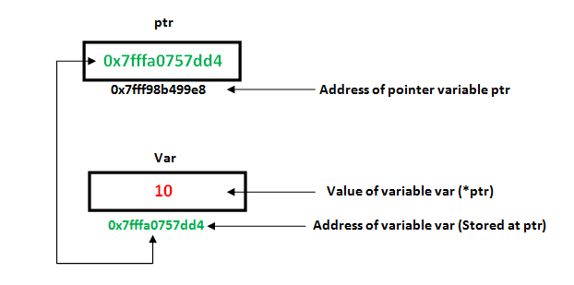
Memory allocation

Slide 6
Pointers usage
A limited set of arithmetic operations can be performed on pointers. A pointer may be:
incremented ( ++ )
decremented ( — )
an integer may be added to a pointer ( + or += )
an integer may be subtracted from a pointer ( – or -= )

Slide 7
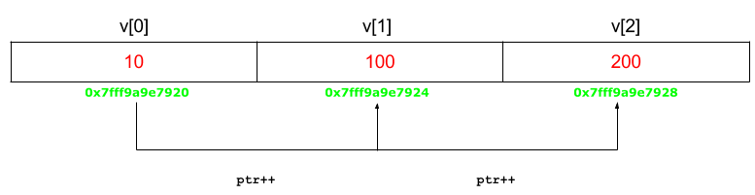
Operations on Pointers

Slide 8
Array names as properties
An array name acts like a pointer constant. The value of this pointer constant is the address of the first element.
For example, if we have an array named val then val and &val[0] can be used interchangeably.

Slide 9
The NULL Pointer
At the very high level, we can think of NULL as null pointer which is used in C for various purposes. Some of the most common use cases for NULL are
a) To initialize a pointer variable when that pointer variable isn’t assigned any valid memory address yet.
b) To check for null pointer before accessing any pointer variable. By doing so, we can perform error handling in pointer related code e.g. dereference pointer variable only if it’s not NULL.
c) To pass a null pointer to a function argument when we don’t want to pass any valid memory address.

Slide 10
The Null Pointer
The example of a) is
int * pInt = NULL;

Slide 11
The example of b) is
if(pInt != NULL) /*We could use if(pInt) as well*/ { /*Some code*/} Else { /*Some code*/}
The example of c) is
int fun(int *ptr) {
/*Fun specific stuff is done with ptr here*/ return 10; }
fun(NULL);

Slide 12
Queue Data Structure
Queue is also an abstract data type or a linear data structure and just like stack data structure in which the first element is inserted from one end called the REAR(also called tail), and the removal of existing element takes place from the other end called as FRONT(also called head).
This makes queue as FIFO(First in First Out) data structure, which means that element inserted first will be removed first.

Slide 13
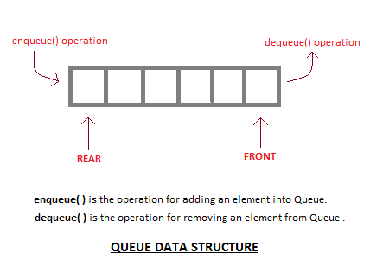
Queue Data Structure

Slide 14
Structures in C
struct Books { char title[50]; char author[50]; char subject[100]; int book_id; };

Slide 15
Allocating memory to a struct
In order to create a linked list in C, we need to allocate memory for it
A memory slot the size of the struct we declared as follows
head = (node*)malloc(sizeof (struct node));
Size of memory needed to be allocated
Variable name
Cast needed due to return malloc return type
Instruction used to allocate memory

Slide 16
String s = (String)methodReturnsObject();

Slide 17
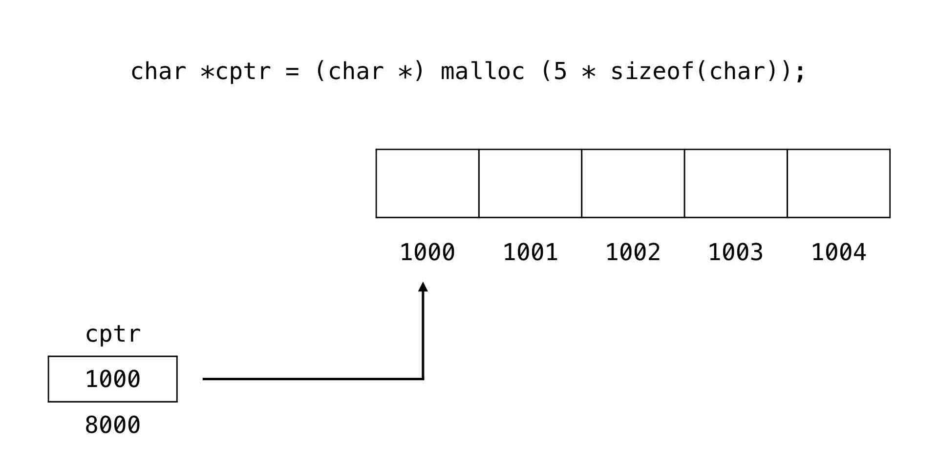
What happens after malloc?
After malloc is called this happens in memory

Slide 18
Modelling a List Node
A node in a Linked List is the basic building block
A node contains information (e.g. Names, Phones, Addresses, etc) plus a reference (pointer) to the next node
A Singly Linked has ONE pointer to the next element

Slide 19
Singly Linked Lists
Since Singly Linked Lists have only one pointer, traversing the list is different than traversing an array
You can only go through the list in one way
The last node of the list, points its “next” reference to NULL

Slide 20
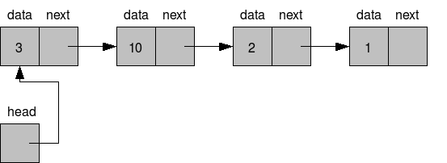
Singly Linked Lists

Slide 21
How to create a SLL
CODE

Slide 22
End of presentation

